Slide 1

How Do You Know When
Your Programs Really Work?
Evaluation Essentials for Program Managers
Session 3: SPECIFIC STRATEGIES
Anita M. Baker, Ed.D.
Evaluation Services
Hartford Foundation for Public Giving,
Nonprofit Support Program: BEC
Bruner Foundation
COPYRIGHT © by the Bruner Foundation 2012

Slide 2
Steps to Take When Analyzing Record Review Data
Before data are collected, determine what is needed, what is available and what is required to collect the information (e.g., permission, IRB clearance).
Where possible, establish targets for comparative purposes.
Develop dummy-tables (i.e., tables with titles and labels, but no data), and graphs and then determine what calculations are necessary to complete them. Finalize an analysis plan.
Perform the calculations (e.g., summaries, means, totals etc. for subgroups of interest and the whole group) and record the information into the table.
Where feasible compare results to targets (including data from prior years, externally determined standards, or the best professional hunch).
Use bulleted lists to make statements summarizing what is presented in the table or graph.

Slide 3
Record Review Example: Descriptive (Example of a Dummy Table)
 | CDR | EF | MHA | MS | CENTRAL | TOTAL
Number of Participants
AGE at INTAKE
17 and Younger
18 – 21
22 – 34
35 – 49
50 – 64
65 and Older
PRIMARY DISABILITY
Neurological
Developmental/Cognitive
Physical
Chronic Disease/Illness
Psychiatric
Sensory
Other

Slide 4
Record Review Example: Descriptive
 | CDR | EF | MHA | MS | CENTRAL | TOTAL
Number of Participants | 32 | 45 | 33 | 43 | 157 | 310
AGE at INTAKE
17 and Younger | 3% | 4% | 0 | 0 | 10% | 7%
18 – 21 | 0 | 13% | 0 | 0 | 47% | 20%
22 – 34 | 13% | 29% | 19% | 7% | 18% | 17%
35 – 49 | 39% | 27% | 34% | 40% | 28% | 30%
50 – 64 | 36% | 22% | 38% | 47% | 19% | 23%
65 and Older | 10% | 4% | 9% | 7% | 0 | 4%
PRIMARY DISABILITY
Neurological | 22% | 60% | 3% | 98% | 0 | 27%
Developmental/Cognitive | 19% | 31% | 0 | 0 | 78% | 43%
Physical | 6% | 0 | 0 | 0 | 2% | 2%
Chronic Disease/Illness | 3% | 0 | 0 | 0 | 1% | 1%
Psychiatric | 19% | 4% | 97% | 0 | 11% | 19%
Sensory | 9% | 2% | 0 | 0 | 1% | 1%
Other | 22% | 2% | 0 | 2% | 7% | 6%

Slide 5
Results 1: Goals vs. Actual
The ASAP project was training high school graduates to increase their eligibility for acceptance into post-secondary programs.

Slide 6
Attendance Intensity:
SOAR Initiative 2008-09
SPRING SEMESTER | New Schools | Existing Schools
 | n=1140 | n=915
Average Attendance ASP | 146.5 hrs | 166.9 hrs
Total Hours ⬇
Low (1 - 45) | 45% | 30%
Mid (46 - 99) | 17% | 17%
High (100 - 144) | 11% | 19%
Accelerated (145+) | 28% | 35%
Target: 50% high Attendance
39%
54%
Which group did better, New or Existing?
What proportion altogether of the new participants had 100 or more hours or attendance? Did they meet their target?

Slide 7
Steps to Take When Analyzing Survey Data
Before survey is administered, determine how data will be collected, (electronically, hard copy, via phone, through checklist or group response).
Where possible, establish targets for comparative purposes.
Develop dummy-tables (i.e., tables with titles and labels, but no data), or graphs and then determine what calculations are necessary to complete them. Finalize an analysis plan.
Perform the calculations (e.g., summaries, means, totals etc. for subgroups of interest and the whole group) and record the information into the table or graph.
Where feasible compare results to targets (including data from prior years, externally determined standards, or the best professional hunch).
Use bulleted lists to make statements summarizing what is presented in the table or graph.

Slide 8
Survey Findings Example
Percent of Training Participants (N=93) who Think AAV Helped or Will Help Them:⬇ | Some | A Lot | TOTAL
Discuss issues of violence with clients | 45% | 55% | 100%
Provide positive interventions for clients | 32% | 65% | 97%
Understand the importance of self-care/stress reduction | 38% | 58% | 96%
Access additional strategies for self-care/stress reduction | 47% | 51% | 98%
Offer clients new ways to:
De-escalate Situations | 31% | 67% | 98%
Manage Anger | 54% | 43% | 97%
Do safety planning | 45% | 52% | 97%
Conduct Bystander Interventions | 39% | 58% | 97%
Target = 50% or more say “a lot” to each

Slide 9
Survey Findings Example
% of 2005-06 Freshman who . . . | Peer Study Group |  | Total
 | Yes n=232 | No n=247 | N=479
Reported struggling to maintain grades | 36% | 58% | 47%
Are planning to enroll for the sophomore year at this school | 89% | 72% | 80%
Note: A total of 1000 Freshmen were enrolled 2005-06, about ½ of whom were involved in Peer Study groups.

Slide 10
After School Program Feedback
Table 4a: Percent of Respondents Who Thought Participation in Theatre
Classes and the Spring Production Helped* Them in the Following Ways
* Some or A lot | 9th Grade n=71 | 10/11th Grade n=97
Work collaboratively with others | 90% (41%) | 95% (58%)
Try new things | 85% (37%) | 96% (58%)
Listen actively | 84% (37%) | 89% (55%)
See a project through from beginning to end | 79% (32%) | 81% (39%)
Learn to value others’ viewpoints | 71% (33%) | 78% (29%)
Become more confident in front of others | 68% (35%) | 82% (46%)
Use an expanded vocabulary | 67% (21%) | 72% (28%)
With memorization | 63% (29%) | 78% (40%)
Express yourself with words | 63% (16%) | 83% (35%)

Slide 11
E-Surveys – Primary Uses
Collecting survey data
  Alternative Administration
  Increases ease of access for some
Generating hard copy surveys
Entering and analyzing data

Slide 12
E-Surveys – Key Decisions
What Question types do you need?
  How will they be displayed?
  Do you need an “other” field?
  Should they be “required?”
How will you reach respondents?
How will you conduct follow-up?

Slide 13

Analyzing Observation Data
Make summary statements about trends in your observations
  Every time we visited the program, the majority of the children were involved in a literacy development activity such as reading, illustrating a story they had read or written, practicing reading aloud.
Include “snippets” or excerpts from field notes to illustrate summary points.

Slide 14
Analyzed Observation Data
  Many different types of arts activities were undertaken, and personal development was either delivered directly or integrated with arts activities. Of the 57 different combinations of programming at the 10 sites, only 3 included activities that were not wholly successful with their target groups, 2 of those because of mismatch between instructor and the participant group. At all sites, ongoing projects were underway and examples of participant work were readily visible. Teaching artists were demonstrating skills, giving youth opportunities to try the skills, and providing one-on-one assistance as needed.

Slide 15
Analyzing Interview Data
    Read/review completed sets of interviews.
    Record general summaries
    Where appropriate, encode responses.
    Summarize coded data
    Pull quotes to illustrate findings.

Slide 16
Analyze interviews Participatory Evaluation Essentials, pp. 116 - 119

Slide 17

Enhancing Presentation Appearance
Consider:
Use of Color
Use of Tables and Graphs
Use of Text-Boxes and Side Bar Stories
Use of Other Graphic Strategies
Use of Pull-out Quotes
Findings as Headings
Recommendations as Headings
Executive Summary (3-5 pages with all
findings, conclusions as summary
statements or bullets)

Slide 18
General Characteristics of Effective Tables and Graphs
    The table or graph should present meaningful data.
    The data should be unambiguous.
    The table or graph should convey ideas about data efficiently.

Slide 19
Thinking About Tables and Figures
    Tables are organized as a series
    of rows➔ and columns ⬇.
      The first step to constructing a table is to determine how many rows and columns you need.
    The individual boxes or “cells” of the table contain the information you wish to display.

Slide 20
Thinking About Tables and Figures
    Tables must have a table number and title (be consistent). Where possible, use the title to describe what is really in the table.
      Table 1: Percent of Respondents Agreeing with Each Item in the Customer Satisfaction Scale.
    All rows and columns must have headings.
    It should be clear what data are displayed (n’s, %s)
    You don’t have to show everything, but a reader should be able to independently calculate what you are displaying. Clarify with footnotes if needed.
    Use lines and shading to further emphasize data.

Slide 21

Thinking About Tables and Figures
    Figures, which include graphs/charts and pictures or any other visual display also must have a figure number and title (be consistent). Like tables, use the title to describe what is really in the figure.
      Figure 1.3 Exit Status of 2006 Domestic Violence Program Participants.
    For bar and line graphs, both the X ➔ and Y ⬆ axes must be clearly labeled.
    The legend, clarifies what is shown on the graph. You can also add individual data labels if needed.
    For any bar or line graph with multiple data groups, be sure to use contrasting colors – that are printable in black and white.

Slide 22
Rules for Pie Charts
Avoid using pie charts
Use pie charts only for data that add up to some meaningful total
Never use three-dimensional pie charts
Avoid forcing comparisons across more than one pie chart.

Slide 23
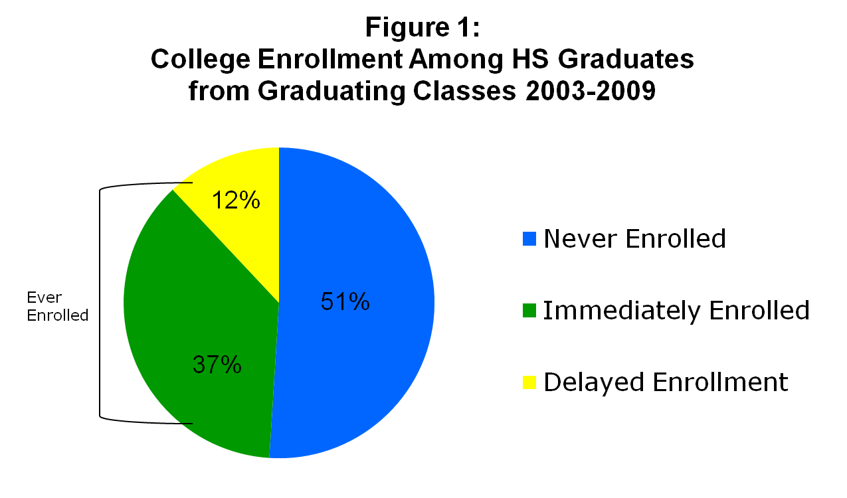
Pie Charts Show Composition of a Whole Group

Slide 24
Rules for Bar Graphs
Minimize the ink. Do not use 3-D effects.
Sort the data on the most significant variable.
Use rotated bar charts (i.e., horizontal) if there are more than 8 – 10 categories
Place legends inside or below the plot area
Keep the gridlines faint.
With more than one data series beware of scaling distortions.
Bar charts often contain little data, a lot of ink and rarely reveal ideas that cannot be presented more simply in a table.

Slide 25
Title
Figure 1: Mean Tuition & Fees, Per Semester Illinois Public Universities, 2001
Data
Label
Legend
Grid Line
$4340
Graphical Elements
$3710
Y-axis scale
$3387
X-axis label
University
X-axis title

Slide 26
Bar Graphs Show Frequencies
Vertical or Horizontal
Percent of CSI Participants with High Attendance
(100 or more hours), by Year
Notes:
25

Slide 27
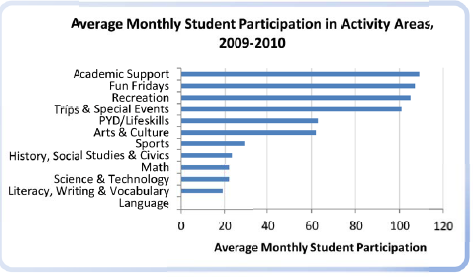
Bar Graphs Show Frequencies
Horizontal or Vertical

Slide 28
Bars Can Be “Stacked” to Show Distribution
Use with caution especially when there is no implicit order to the categories.
Stacked bar charts work best when the primary comparisons are to be made across the data series represented at the bottom of the bar.

Slide 29
Figure 3: Survey Results:
Percent of Principals Who are Satisfied with 6th Grade Literacy Achievement at Community Schools and Comparison Schools
66%
Community Schools
n-=12
Comparison Schools
n-=13
Notes:
Howard

Slide 30
Line Graphs Show Change Over Time
Figure 6.7 Proportion of Students Passing
Proficiency Test

Slide 31
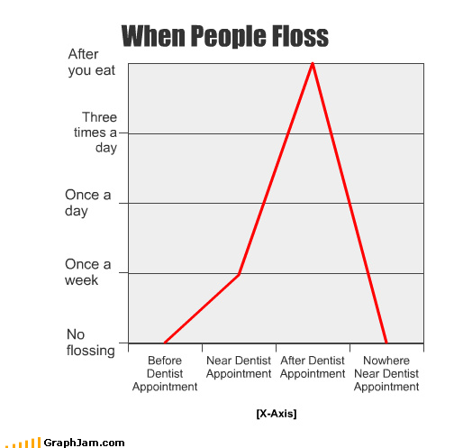
Time Segments Must be Meaningful, Usually Presented on the X Axis

Slide 32
General Characteristics of Effective Tables and Graphs
    The table or graph should present meaningful data.
    The data should be unambiguous.
    The table or graph should convey ideas about data efficiently.

